Slide 1
Black Friday
Kit Adv 2025

Slide 2


Key Visual

Slide 3


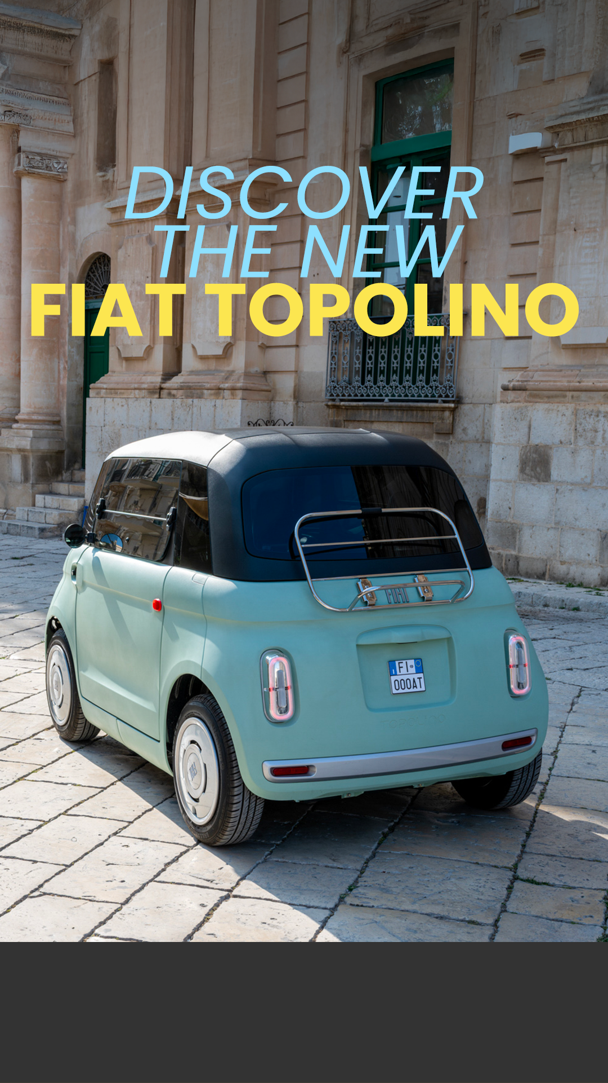

Story animated
STICKER LINK CTA:
DISCOVER THE OFFER

Slide 4
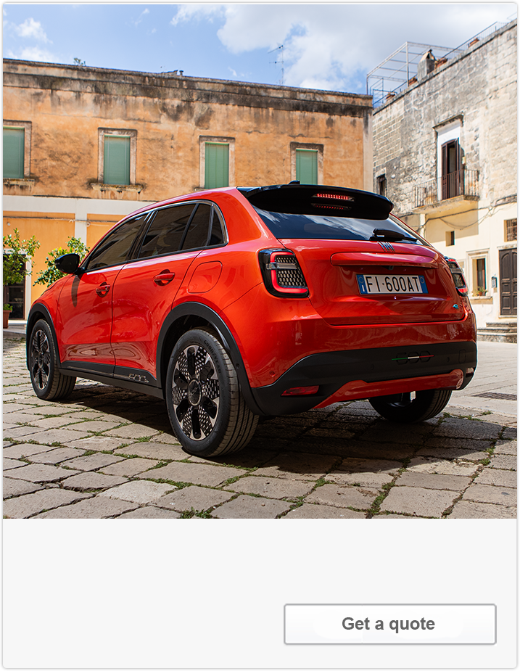
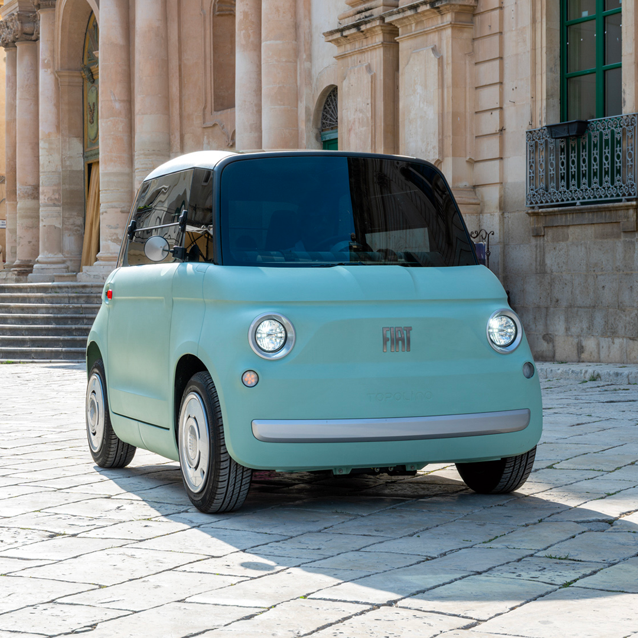
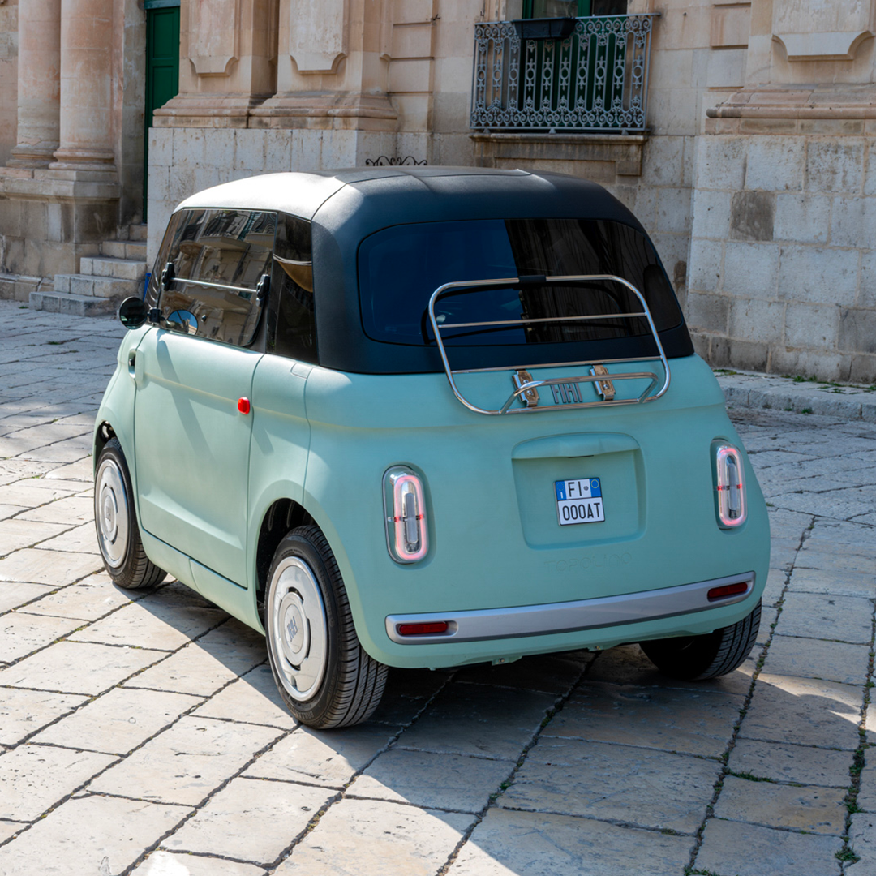



Carousel
COPYPOST
Your Friday isn’t black anymore: discover the joy of Topolino and shine all year long.
FRIDAYS SHOULDN’T BE BLACK
FIAT MAKES THEM COLORFUL
AND TOPOLINO GETS YOU EVERYWHERE [DETAIL TBD]
FEEL THE CHARM AND JOY [DETAIL TBD]
LOCAL PROMO
Get a quote
Get a quote
Get a quote
Geta a quote
*Frame 3 and 4 can have photografic asset or models details

Slide 5






Banner
FRIDAYS SHOULDN’T BE BLACK
FIAT MAKES THEM COLORFUL
DISCOVER THE
NEW FIAT TOPOLINO
AND SHINE ALL YEAR LONG
YOURS FROM XX.XXX
LOCAL PROMO
CTA: DISCOVER THE OFFER
*Frame 3 and 4 can have photografic asset or models details

Slide 6







Story animated
STICKER LINK CTA:
DISCOVER THE OFFER

Slide 7






Carousel
COPYPOST
Your Friday isn’t black anymore: discover the joy of Fiat Range and shine all year long.
ALT
FRIDAYS SHOULDN’T BE BLACK
FIAT MAKES THEM COLORFUL
DISCOVER THE FIAT RANGE
STAY ALWAYS JOYFUL
AND SHINE ALL YEAR LONG
Get a quote
Get a quote
Get a quote
Geta a quote
CTA: DISCOVER THE OFFER

Slide 8





Banner Range
YOUR FRIDAY ISN’T BLACK ANYMORE
FIAT MAKES IT COLORFUL
DISCOVER THE
FIAT RANGE
AND SHINE ALL YEAR LONG
LOCAL PROMO
CTA: DISCOVER THE OFFER

Slide 9
Thank You

